Slide 1
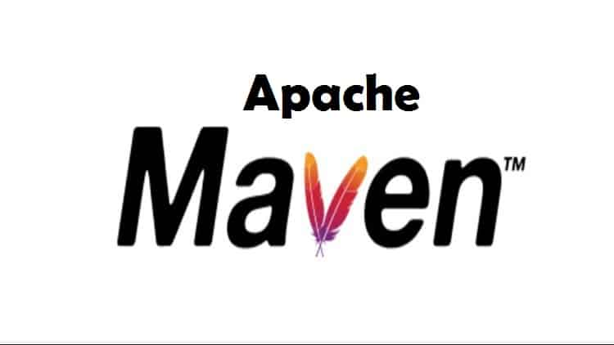
Apache Maven

Slide 2
What is Maven?
Maven is a popular open-source build tool developed by the Apache Group to build, publish, and deploy several projects at once for better project management. The tool provides allows developers to build and document the lifecycle framework.

Slide 3
Maven provides developers ways to manage the following:
Builds
Documentation
Reporting
Dependencies
SCMs
Releases
Distribution
Mailing list

Slide 4
Based on the Project Object Model (POM)
To summarize, Maven simplifies and standardizes the project build process.
It handles compilation, distribution, documentation, team collaboration and other tasks seamlessly.
Maven increases reusability and takes care of most of the build related tasks.

Slide 5
Maven History
Apache group then developed Maven which can build multiple projects together, publish projects information, deploy projects, share JARs across several projects and help in collaboration of teams.
Maven Goals
A comprehensive model for projects, which is reusable, maintainable, and easier to comprehend.
Plugins or tools that interact with this declarative model.
Maven project structure and contents are declared in an xml file, pom.xml, referred as Project Object Model (POM), which is the fundamental unit of the entire Maven system.

Slide 6
POM stands for Project Object Model.
It is fundamental unit of work in Maven. It is an XML file that resides in the base directory of the project as pom.xml.
The POM contains information about the project and various configuration detail used by Maven to build the project(s).
POM also contains the goals and plugins. While executing a task or goal, Maven looks for the POM in the current directory. It reads the POM, gets the needed configuration information, and then executes the goal. Some of the configuration that can be specified in the POM are following:
project dependencies
plugins
goals
build profiles
project version
developers
mailing list

Slide 7
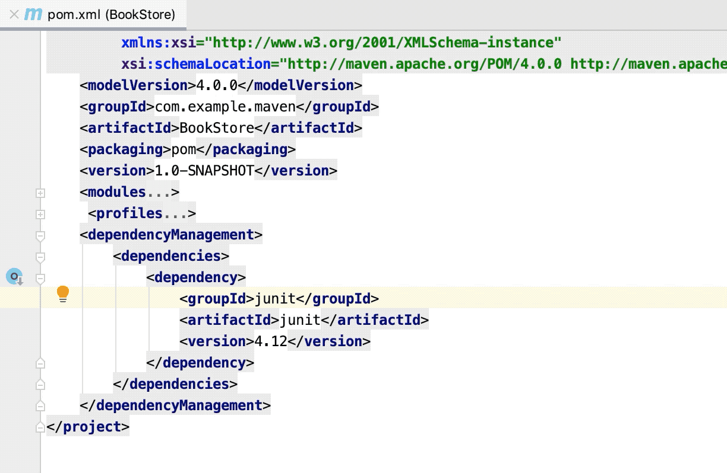
Before creating a POM, we should first decide the project group (groupId), its name (artifactId) and its version as these attributes help in uniquely identifying the project in repository

Slide 8
Maven Build Lifecycle
Prepare resourse
Validate
Compile
Test
Package
Install
Site
Clean

Slide 9
Goal:-
A goal represents a specific task which contributes to the building and managing of a project. It may be bound to zero or more build phases. A goal not bound to any build phase could be executed outside of the build lifecycle by direct invocation.
Compile :- mvn compile
Compiles source code of the project.
Test :- mvn test
The Maven surefire plugin provides a “test” parameter that we
can use to specify test classes or methods we want to execute
Package :- mvn package
Creates JAR or WAR file for the project to convert it into a
distributable format.

Slide 10
install :- mvn install
install the package into the local repository, for use as a dependency in other projects locally.
Site :-mvn site
Clean :- mvn clean
is bound to the clean phase in the clean lifecycle. Its clean:cleangoal deletes the output of a build by deleting the build directory. Thus, when mvn clean command executes, Maven deletes the build directory.

